Slide 1

GE100 - Application of Information and Communication Technologies
Lec # 6: Network and Communication Devices
Instructor: Alina Maryum

Slide 2
Learning Objectives
Define a computer network and its purpose
Describe several uses for networks
Types of Networks
Understand the various characteristics of a network, such as topology, architecture, and size

Slide 3
What Is a Network?
Network
A connected system of objects or people
Computer network
A collection of computers and other hardware devices that are connected together so users can share hardware, software, and data, as well as, communicate electronically with one another
Computer networks are converging with telephone and other communications networks with both data and voice being sent over these networks
Networks range from small private networks to the Internet
Used by individuals and businesses today

Slide 4
Uses for computer networks
Sharing an Internet connection among several users
Sharing application software, printers, and other resources
Facilitating Voice over IP (VoIP), e-mail, videoconferencing, messaging, and other communications applications
Working collaboratively; for example, sharing a company database or using collaboration tools to create or review documents
Exchanging files among network users and over the Internet
Connecting the computers and the entertainment devices (such as TVs, gaming consoles, and stereo systems) located within a home

Slide 5
Networking Applications
Networking applications are tools or software that use internet connections to provide services like communication, file sharing, and remote access. They are essential in business, education, healthcare, and everyday life.
Types of Networking Applications
Communication Applications
Email (e.g., Gmail): Uses SMTP protocol to send and receive messages.
Instant Messaging (e.g., WhatsApp): Real-time text and media sharing.
Video Conferencing (e.g., Zoom): Supports remote meetings with audio and video.

Slide 6
Types of Networking Applications
File Sharing and Storage
FTP Clients (e.g., FileZilla): Transfer files across networks.
Cloud Storage (e.g., Google Drive): Store and access files online.
E-Commerce and Banking
Online Shopping (e.g., Amazon): Secure online transactions.
Online Banking (e.g., PayPal): Financial transactions over the network.
Remote Access Tools RDP (Remote Desktop), SSH (Secure Shell): Secure remote computer access.
Web-Based Applications
Browsers (e.g., Chrome): Access web pages via HTTP/HTTPS.APIs (e.g., Google Maps API): Enable data exchange between applications.

Slide 7
Types of Networking Applications
Industry Uses
Healthcare: Telemedicine and health data sharing.
Education: Virtual classes and resource sharing.
Government: Secure communication channels.
Network Infrastructure
Client-Server Model: Centralized servers providing services to clients.
Peer-to-Peer (P2P): Direct file sharing among users.
Cloud Computing: Internet-based storage and computing power.

Slide 8
Types of Networking Applications
Security in Networking Applications
Encryption (SSL/TLS): Protects data transfer.
VPNs: Secure, private connections over the internet.
Emerging Trends
IoT: Devices connected to the internet (smart homes).
5G: Faster internet for high-speed applications like VR.
AI in Networking: Automated responses and smart network management.

Slide 9
Types of Networks
Local Area Network (LAN)
Definition: A network that connects devices within a limited area, such as a single building or campus.
Characteristics:
High-speed data transfer rates.
Uses Ethernet or Wi-Fi for connectivity.
Topology: Common topologies in LANs are star, bus, and hybrid.
Uses: Offices, schools, and home networks for sharing files, printers, and internet access

Slide 10
Types of Networks
Personal Area Network (PAN)
Definition: A small network used for connecting devices close to an individual, typically within a range of a few meters.
Examples: Connecting a smartphone to a laptop via Bluetooth or using a wireless keyboard with a computer.
Uses: Primarily for personal use, such as data transfer between devices or connecting peripherals.

Slide 11
Types of Networks
Metropolitan Area Network (MAN)
Definition: A network that spans a city or large campus, connecting multiple LANs within a metropolitan area.
Characteristics:
Larger than a LAN but smaller than a WAN.
Often uses fiber-optic cables for high-speed connectivity.
Uses: Connecting branch offices within a city, providing city-wide Wi-Fi, or for municipal services (e.g., traffic monitoring).

Slide 12
Types of Networks
Wide Area Network (WAN)
Definition: A network that covers a large geographic area, often spanning cities, states, or even countries.
Characteristics:
Connects multiple LANs and MANs.
Uses leased telecommunications lines, fiber optics, or satellite links.
Examples: The internet is the largest example of a WAN.
Uses: For global communication and data sharing across distant locations (e.g., multinational corporations).

Slide 13
Types of Networks
Virtual Private Network (VPN)
Definition: A network that uses the internet to provide secure connections between remote users and a private network.
Characteristics:
Creates an encrypted “tunnel” for data transfer, protecting data from eavesdropping.
Uses: For secure remote access to a company’s network from anywhere in the world.

Slide 14
Types of Networks
What is a VPN?
A Virtual Private Network (VPN) is a secure connection between your device (like a computer or phone) and the internet. It works by creating an encrypted tunnel that protects your data as it travels between your device and the websites or services you’re accessing online.
Think of a VPN like a private, secure tunnel through which only you can send and receive data, even though you’re using the public internet.

Slide 15
Types of Networks
Common Uses of VPNs
Secure Browsing on Public Wi-Fi: VPNs protect you when using public Wi-Fi by preventing others on the same network from seeing what you’re doing.
Accessing Work Networks Remotely: Employees working from home can securely access their company’s network.
Bypassing Regional Restrictions: People use VPNs to access streaming content or websites available only in certain countries.

Slide 16
Network Characteristics
Scalability: Ability to expand the network by adding more devices or resources without impacting performance.
Security
Data Encryption: Protects data during transfer to ensure privacy.
Authentication: Verifies the identity of users (e.g., passwords, biometrics).
Access Control: Limits who can view or use network resources.
Topology: The layout of a network, such as Star, Bus, Ring, or Mesh, affecting performance and resilience.
Cost-Effectiveness: Balancing performance, reliability, and scalability with budget constraints.
Availability: Ensures that network services are accessible whenever needed, often represented as a percentage (e.g., 99.9% uptime).

Slide 17
Network Characteristics
Key Characteristics of Networks:
Performance
Bandwidth: The amount of data transmitted over a network in a given time (e.g., Mbps).
Latency: Delay in data transmission; lower latency is better for real-time applications.
Throughput: Actual data transfer rate, affected by network traffic and capacity.
Reliability
Fault Tolerance: The network’s ability to continue operating despite failures (e.g., backup routes).
Downtime: The period when a network is unavailable; reliability minimizes downtime

Slide 18
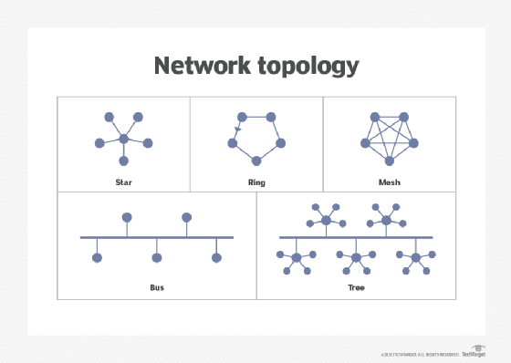
Network Topology
Network topology refers to the physical or logical arrangement of devices (nodes) and connections (links) in a network.
It defines how computers, printers, routers, and other devices are connected, which impacts the network's performance, reliability, and scalability.

Slide 19
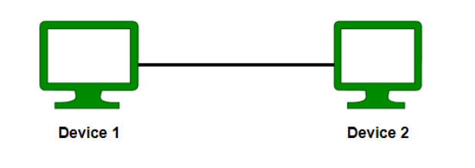
Types of Network Topologies
Point to Point Topology
Point-to-point topology is a type of topology that works on the functionality of the sender and receiver. It is the simplest communication between two nodes, in which one is the sender and the other one is the receiver. Point-to-Point provides high bandwidth.

Slide 20
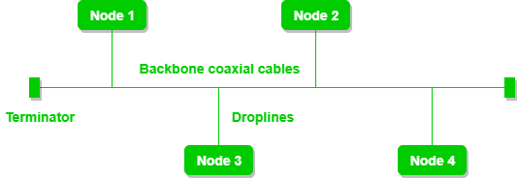
Types of Network Topologies
In bus topology, all devices (nodes) are connected to a single central cable called the "bus" or "backbone." Data sent by any device travels along this cable and is available to all devices. Devices listen for data addressed specifically to them.
Media Used: Coaxial cable was commonly used in early bus networks, but twisted-pair or fiber-optic cables are sometimes used in modern implementations.
Advantages:
Simple and inexpensive to install for small networks.
Requires less cabling than some other topologies.
Disadvantages:
Limited scalability; performance slows with many devices.
Difficult to troubleshoot; if the central cable fails, the entire network goes down.
Data collisions can occur, especially with high traffic, leading to slow performance.

Slide 21
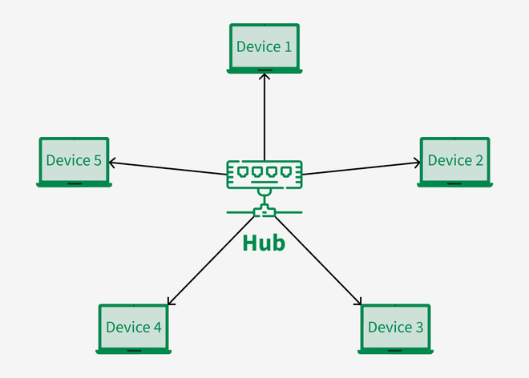
Types of Network Topologies
In a star topology, all devices are connected individually to a central hub or switch. The hub manages and directs data traffic between devices.
Media Used: Twisted-pair cables (e.g., Cat5e, Cat6 Ethernet cables) are most common, though fiber-optic cables can be used for higher performance.

Slide 22
Star Topology
Advantages:
Disadvantages:
Easy to install, manage, and troubleshoot, as each device has its own dedicated connection.
If one device or cable fails, other devices remain unaffected.
Good scalability; new devices can be added easily.
The central hub or switch is a single point of failure—if it fails, the whole network goes down.
Requires more cabling than bus topology, which can increase costs.

Slide 23
Star Topology (Cont..)
In a Star Topology, hubs and switches are critical components, as they serve as the central point through which all devices (nodes) connect and communicate. Here’s an overview of each and their roles in a star network:
Hub
Function: A hub is a basic, simple device that connects multiple devices in a network. When data is received by the hub, it broadcasts (sends) the data to all connected devices, regardless of the intended recipient.
Operation: Hubs operate at Layer 1 (Physical Layer) of the OSI model, meaning they simply pass data along without interpreting or filtering it.

Slide 24
Cont…
2. Switch
Function: A switch is a more advanced device than a hub. When a switch receives data, it intelligently directs the data to the specific device it’s meant for, rather than broadcasting it to all devices.
Operation: Switches operate at Layer 2 (Data Link Layer) of the OSI model. They use MAC (Media Access Control) addresses to identify devices and create direct paths for data, reducing unnecessary traffic.

Slide 25
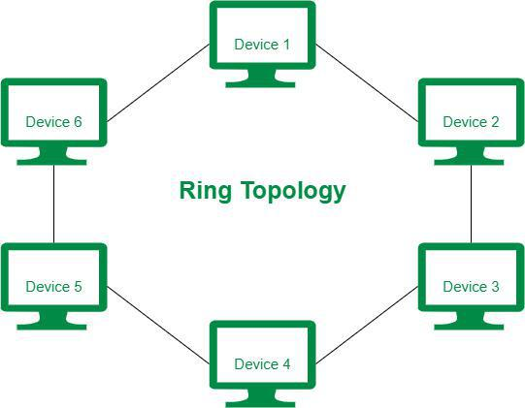
Ring Topology
Description: Devices in a ring topology are connected in a closed loop or "ring," where each device has exactly two neighbors. Data travels in a single direction (unidirectional) or, in some cases, both directions (bidirectional).
Media Used: Fiber-optic or twisted-pair cables are commonly used, especially in large or high-performance setups.
The most common access method of ring topology is token passing.
Token passing: It is a network access method in which a token is passed from one node to another node.
Token: It is a frame that circulates around the network.

Slide 26
Cont..
Advantages: Organized data flow reduces the likelihood of collisions.
Easy to pinpoint faults; if one device fails, it’s clear where the break in the loop is.
Suitable for moderate-sized networks with predictable data flow.
Disadvantages:
If one device or link fails, it can disrupt the entire network unless dual-ring redundancy is used.
Slower data transmission for large networks due to data passing through each device.

Slide 27
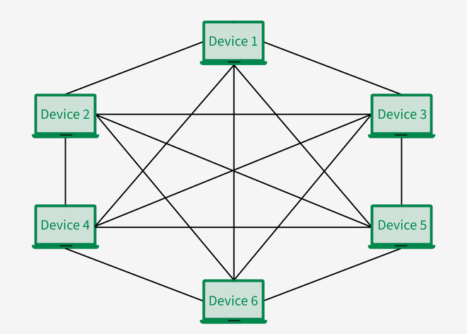
Mesh Topology
Description: In a mesh topology, each device is connected to every other device in the network. This provides multiple pathways for data to travel between devices.
Media Used: Often uses twisted-pair cables for small setups or wireless links in wireless mesh networks. Fiber-optic cables are used for high-speed or extensive mesh networks.

Slide 28
Cont…
Advantages:
Highly reliable; if one link fails, data can reroute through other links.
Excellent fault tolerance and data redundancy, making it ideal for mission-critical applications.
Good performance for handling high traffic.
Disadvantages:
Expensive and complex to install due to extensive cabling and connection points.
Maintenance is challenging, especially in large networks.
Requires more hardware, making it costlier than other topologies.

Slide 29
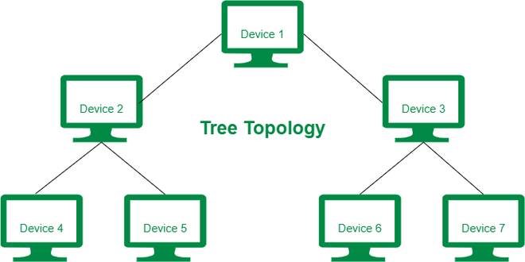
5. Tree Topology (Hierarchical)
Description: Tree topology combines elements of star and bus topologies. Groups of star-configured devices are connected to a central backbone, creating a hierarchical structure.
Media Used: Twisted-pair or fiber-optic cables, depending on the size and speed requirements of the network. The backbone may use a more robust medium like fiber-optic cable, while branches may use Ethernet cables.

Slide 30
Cont..
Advantages:
Scalable; new branches can be added to the network easily.
Centralized monitoring and control, making it suitable for large organizations.
Faults in a branch do not affect the entire network.
Disadvantages:
If the backbone fails, the entire network is affected.
Complex to install and configure, especially with extensive branches.
Requires more cabling, which increases costs.

